Slide 1
Counting Crowds in Real Time using OpenCV
Group Number : 29
Sai Sandeep Manne

Slide 2
INTRODUCTION
People's behavior must be observed, tracked, especially in public areas such as malls and stadiums, where the safety of the public and security are of paramount importance.
With vast crowds, it is hard for a human monitoring operator to accurately observe the crowds’ behavior. As a result, crowd management systems that can count people are being developed with the goal of assisting these human surveillance operators. Counting people on the street or at entrances to venues is useful for security, tracking, and marketing.
Over the last few years, the use of cameras and digitizers for various reasons has increased dramatically. In the past, CCTV surveillance systems required a human operator to monitor the camera's input. The development of an automatic person’s counter to aid in the action has become a need.
I'll use both OpenCV and dlib to make our people counter. For standard computer vision/image processing functions, we'll utilize OpenCV, and for people counting, we'll use the deep learning object detector. After that, we'll utilize dlib to construct correlation filters.

Slide 3
RELATED WORK
W. Liu, M. Salzmann, and P. Fua, Context-aware crowd counting, in Proc. IEEE/CVF Conf. Comput. Vis. Pattern Recognit. (CVPR), Jun. 2019, pp. 50995108.
V. A. Sindagi and V. M. Patel, HA-CCN: Hierarchical attention based crowd counting network, IEEE Trans. Image Process., vol. 29, pp. 323335, 2020.
W. Ge and R. T. Collins, Marked point processes for crowd counting, in Proc. CVPR, Jun. 2009, pp. 29132920
M. Li, Z. Zhang, K. Huang, and T. Tan, Estimating the number of people in crowded scenes by MID based foreground segmentation and head shoulder detection, in Proc. 19th Int.
Conf. Pattern Recognit., Dec. 2008
Shaoqing Ren, Kaiming He, Ross Girshick, and Jian Sun, Faster R-CNN: Towards Real-Time Object Detection with Region Proposal Networks, in arXiv:1506.01497v3 [cs.CV] 6 Jan 2016
Desen Zhou and Qian He, Cascaded Multi-Task Learning of Head Segmentation and Density Regression for RGBD Crowd Counting, Digital Object Identifier 10.1109/ACCESS.2020.2998678, June 10, 2020

Slide 4
METHODOLOGY
1. Video Pre- Processing
Resizing and converting to rgb are used to pre-process frames. OpenCV is a library that may be used to do standard image processing and computer vision tasks. OpenCV will be used to do deep neural network inference, video file reading and writing, and output frame display on our screen.
2.Object Detection
We run our object tracker during the detection phase to detect if new objects have entered our view and see if we can find objects that were "lost" during the tracking phase. We construct or update an object tracker with the new bounding box coordinates for each identified object. We only run this phase once every N frames because our object detector is more computationally intensive.
3. Object Tracking
We construct an object tracker for each of our detected items to follow it around the frame. Compared to the object detector, our object tracker should be quicker and more efficient. We'll keep tracking until we reach frame N, at which point we'll re-run our object detector. The cycle then repeats itself.

Slide 5
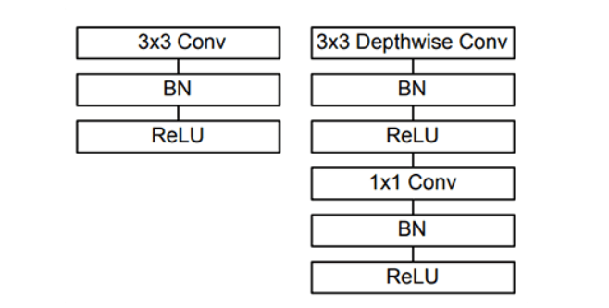
Object Detection : There are three main object detection methods based on deep learning.
1. Faster R-CNNs
2. You Only Look Once (YOLO)
3. Single Shot Detectors (SSDs)
We achieve a quick, efficient deep learning-based object identification approach by combining the MobileNet architecture and the Single Shot Detector (SSD) framework.
In this project, we'll be using a Caffe version of MobileNet SSD as our model. The MobileNet SSD was trained on the COCO dataset (Common Objects in Context).
Mobilenet SSD contains all the pretrained deep learning model files which is used to detect the objects using a convolutional filter.
Left: Standard convolutional layer with batch normalization and ReLU
Right: Depth wise separable convolution with depth wise and pointwise layers followed by batch normalization and ReLU ( Rectified Linear Unit – Activation Function)

Slide 6
FPS Rates compared to the different Object Detection Algorithms:
The R-CNNs algorithm (where "R" stands for "Region Proposal") can be quite sluggish, averaging around 7 frames per second.
If we're going for sheer speed, we'll go with YOLO, which can process 40-90 frames per second on a Titan X GPU.
YOLO's fast version can reach 155 frames per second. YOLO's drawback is that it lacks precision.
Google's SSDs are a compromise between the two.
Faster R-CNNs have a more complicated algorithm. Depending on which network variant we utilize, SSD runs at a rate of 22-56 FPS. SSDs are also more precise than YOLO drives.

Slide 7
Object Tracking :
The algorithm we have used is the centroid tracking algorithm. It is based on the Euclidean distance between existing object centroids and new object centroids between video frames.
The Centroid Tracking Algorithm :
The centroid tracking algorithm consists of several steps.
Calculate centroids using bounding box coordinates.
Calculate the Euclidean distance between existing items and new bounding boxes.
Update (x, y)-coordinates of existing objects
Register new objects
Deregister old objects

Slide 8
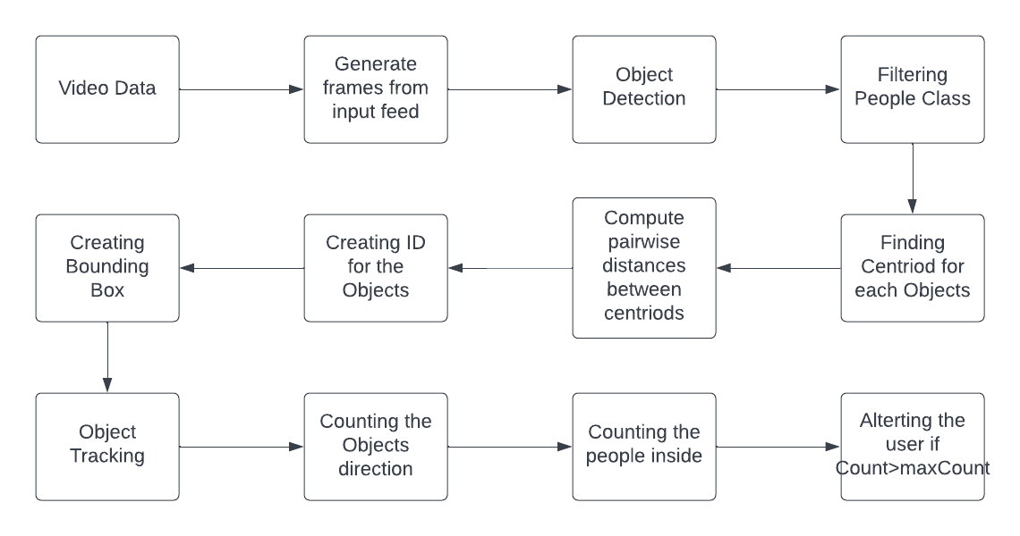
FLOW CHART

Slide 9
EVALUATION
QUANTITATIVE ANALYSIS
FPS: Can be seen at the Command Prompt
Time Duration for compilation of the Video : Can be seen at the Command Prompt
People Count : Can be seen at the Analyzing Window
QUALITATIVE ANALYSIS
People Recognition
People Tracking

Slide 10
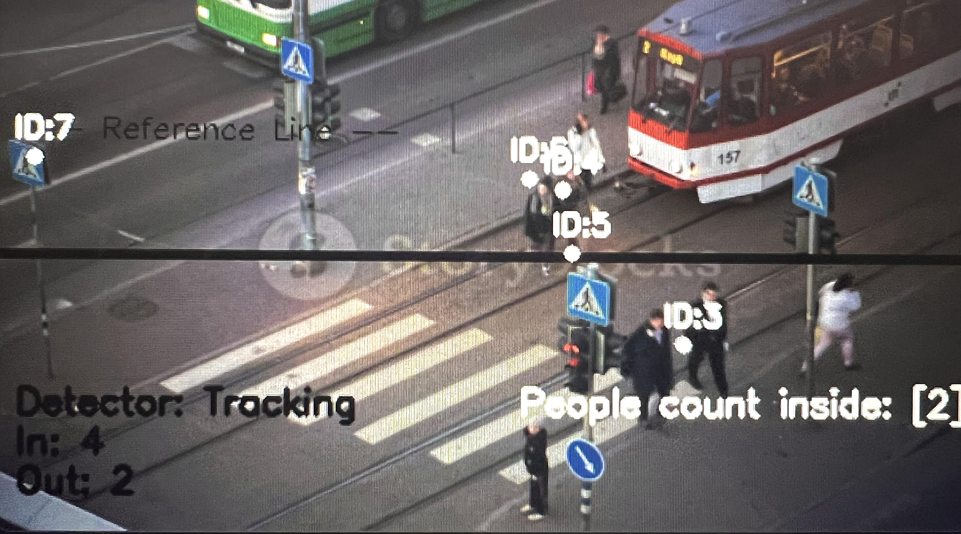
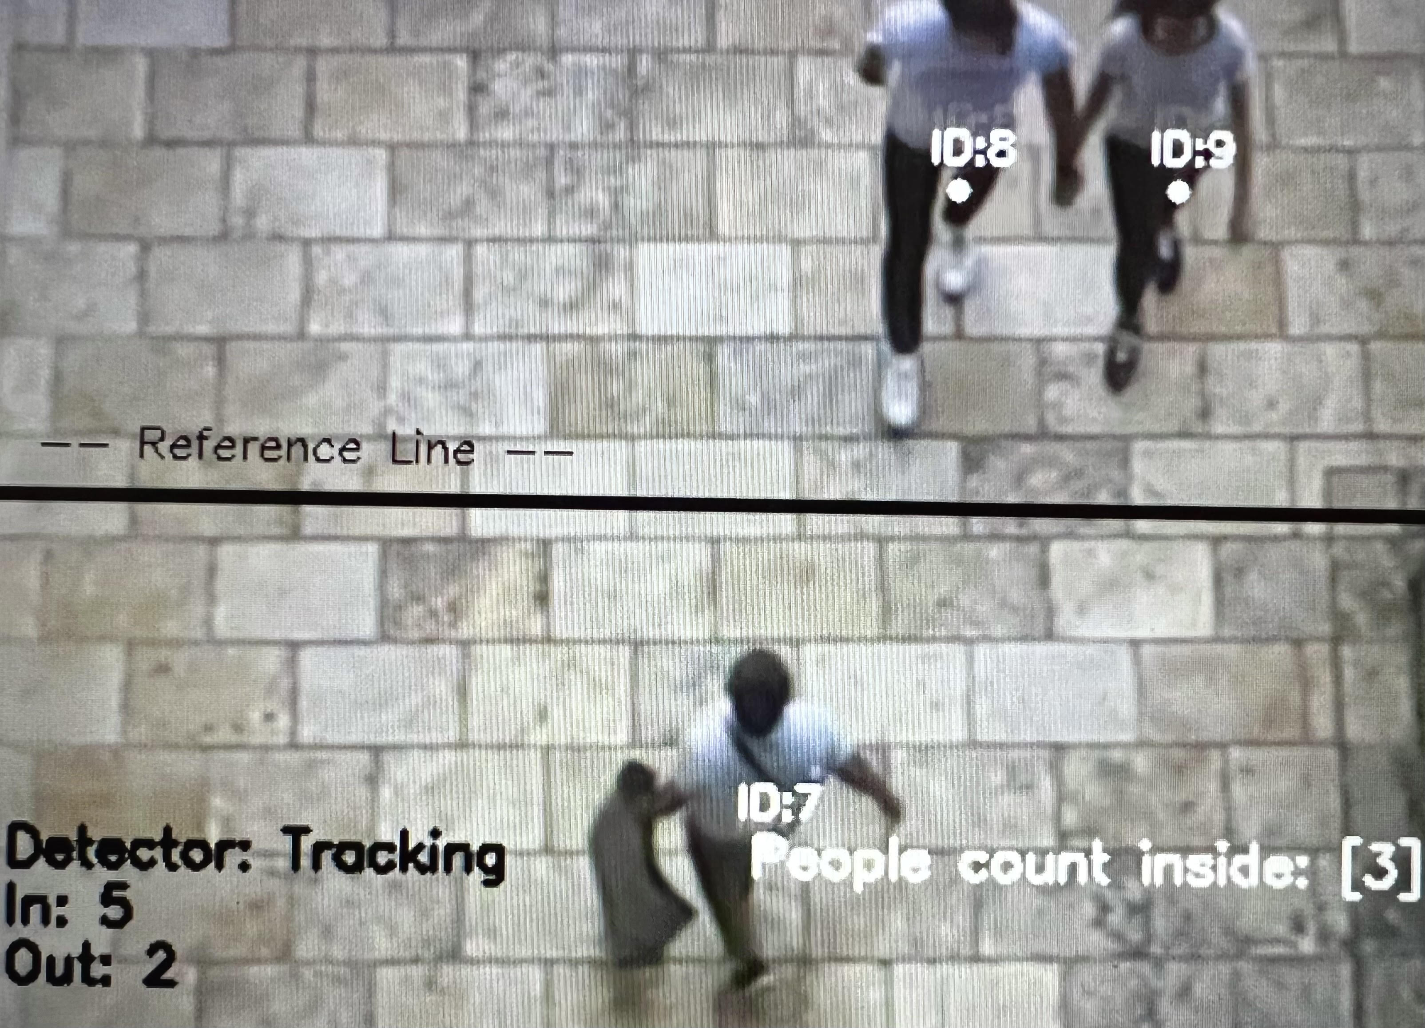
RESULTS

Slide 11
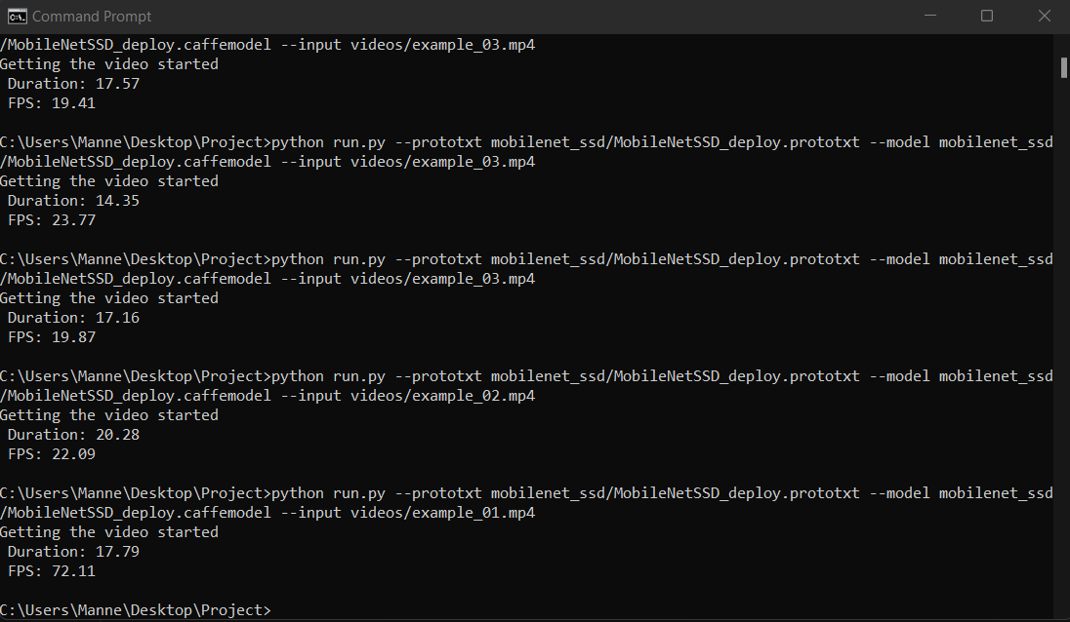
RESULTS
FPS and Elapsed time

Slide 12
PLAN FOR COMPLETION
Enhancing the created model
Addition of Additional Features to the model

Slide 13
REFERENCES
https://arxiv.org/abs/1512.02325
https://betterprogramming.pub/using-python-pandas-with-excel-d5082102ca27
https://www.ijert.org/real-time-crowd-counting-using-opencv
https://towardsdatascience.com/review-ssd-single-shot-detector-object-detection-851a94607d11
https://arxiv.org/abs/1704.04861
https://core.ac.uk/download/pdf/47139441.pdf

Slide 14
THANK YOU

